Slide 1

Remote-sensing and classification of benthic landscapes for satellite derived bathymetry
Sélim Amrari
Master thesis
February, 2018
Supervisors :
Romain Le Gendre, Dr. Hugues Lemonnier, Benoit Soulard
LEADNC, IFREMER - New Caledonia
Prof. Dr. Alfred Johny Wüest Physics of Aquatic Systems Laboratory, EPFL - Switzerland
Notes:
Hello,
Today I m going to make a presentation about my master thesis
It will be about remote-seen
Work achieved in New Caledonia with IFREMER
20 seconde

Slide 2
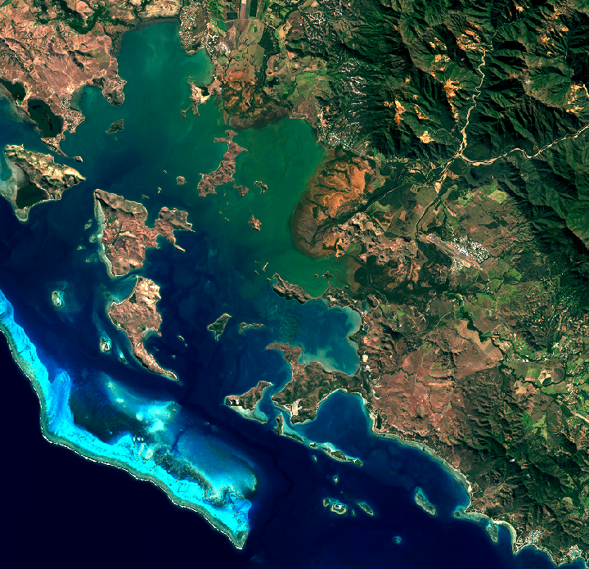
Summary
Introduction
Satellite derived bathymetry, motivation and background
Physic principles in water surrounding
Aims of the thesis
Study site: South part of the new caledonian lagoon
Materials
Methods and results
Workflow
Image pre-processing
Bottom type and water classification
The number of clusters
Empirical modeling
Discussion
Conclusion
Notes:
Shortly lets resume the summary of the presentation
We begin with an introduction: why sdb, how sdb where
Then we ll have a short description of the meterial
We follow by a description the diff step of the methodo and theirs result
Lastly we ll have a disscussion and a final conclusion
30 seconde

Slide 3
Satellite derived bathymetry, motivation and background
Bathymetry, a key variable
PRESENCE :
« PREssions sur les Ecosys- tèmes récifo-lagonaires de Nouvelle-CalédoniE »
Traditional bathymetric measurements:
By echo-sounder at the surface
Expensive
Not achievable everywhere
Satellite derived bathymetry :
Less accurate but…
Large scale water depth retrieval
High Resolution
Maximum depth : 25 – 30 meters
Sate of the art SDB:
Empirical modelling
Semi-analytical modelling
Machine-learning
Classification
Notes:
Why bathymetry.
It is a very important variable. For hyd d model it is taking part of the boudarie condition. For coral ecosystem also, it allow to estimate the vulnarability to storm event and global warming. Here in new it is very interesting as there is several pristine coral areas.
However SDB remain less accurate than traditional measurement which are made by echo-sounder and has a maximum deppth of 25 30 meter in optimal clear water condition. Howerver it offer large scale depth water retrieval at high resolution at a lower cost.
45 seconde
Firt of all why bathymetry
Knowing Bath -> primary necessity. It represent a part of boundarie condition for hydrodinamic model. This is why we need the bathy grid with the highest resolution possible. In addition in coral ecos, it is a very impo variable. Allows to estim vulnerab to storm event and to global warming. Lastly, Lagoon of New Caledonia contain gap in pristine areas.
Traditionnal, bathymetric measurements are made by echo-sounder, a type of sonar, either mono or multi-beam, measuring water depth from sea surface.

Slide 4
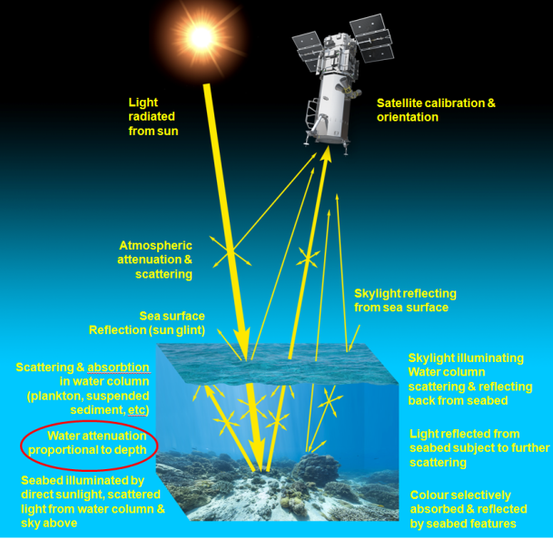

Physic principles in water surrounding
Radiance
recorded by the satellite sensor
corresponds to a measure of the electromagnetic radiation flux emitted or reflected by a surface
dependent on :
The area of the source,
The view and solid angles of the sensor,
The wavelength
The irradiance
Attenuation
Come from the Absorption and the scattering
$$L\left(h\right)=L_{s} −L_{b}e_kh$$
Notes:
Recorded signal by satelite is called the radiance. Not only dependent on the observed surface different, from reflectance
Reflection : is made of two different king of process.
Attenuation occuring in water surrounding produced two primary components. Absorption, molecular process energy of radiation is absorbed by the mater. Scattering which is a change in direction of radiation. It strongly dependent on the wavelength of radiation. Charactherized by a attenutation coefficient dependent on the water optical properties
Why am I telling you that : 3 main factor of variation of the recorded signal occuring in water surrounding. Bottom type _> bottom reflectance. The depth, which increase the amount of attenuation along the pathway, water compound change the water attenuation coefficient

Slide 5
Aims of the thesis
Evaluation of empirical modelling
Direct application on a specific multi-spectral sensor
Discussion of technical issues and procedures
Scale of resolution
Range of optimal depth prediction
Proposed an approach by classification
Notes:
Let s now highlight the aim of this thesis.
Primary aims at evaluating empirical methods of bath retrieval.
This work is applied using data from a specific passive sensor Sentinel2 which has been chosen. It is then a direct application of empircal metods to this sensor. The issues and the applied procedure will be disscussed.
Scale of depth retrieval.
Range of optimal depth w can be predicted
Lastly, an approach based on an initial classification is proposed. As seen the sens sig is dependend on bottom reflec, depth and water optical pro. This approach aims a t isolate the variation of the signal drivent by depth in subdatasets of calibration of models.

Slide 6
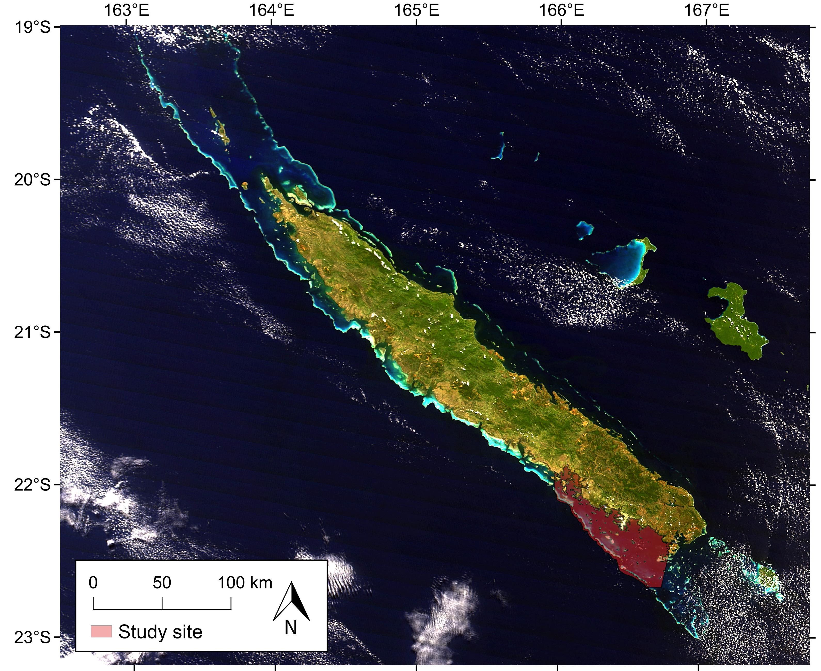
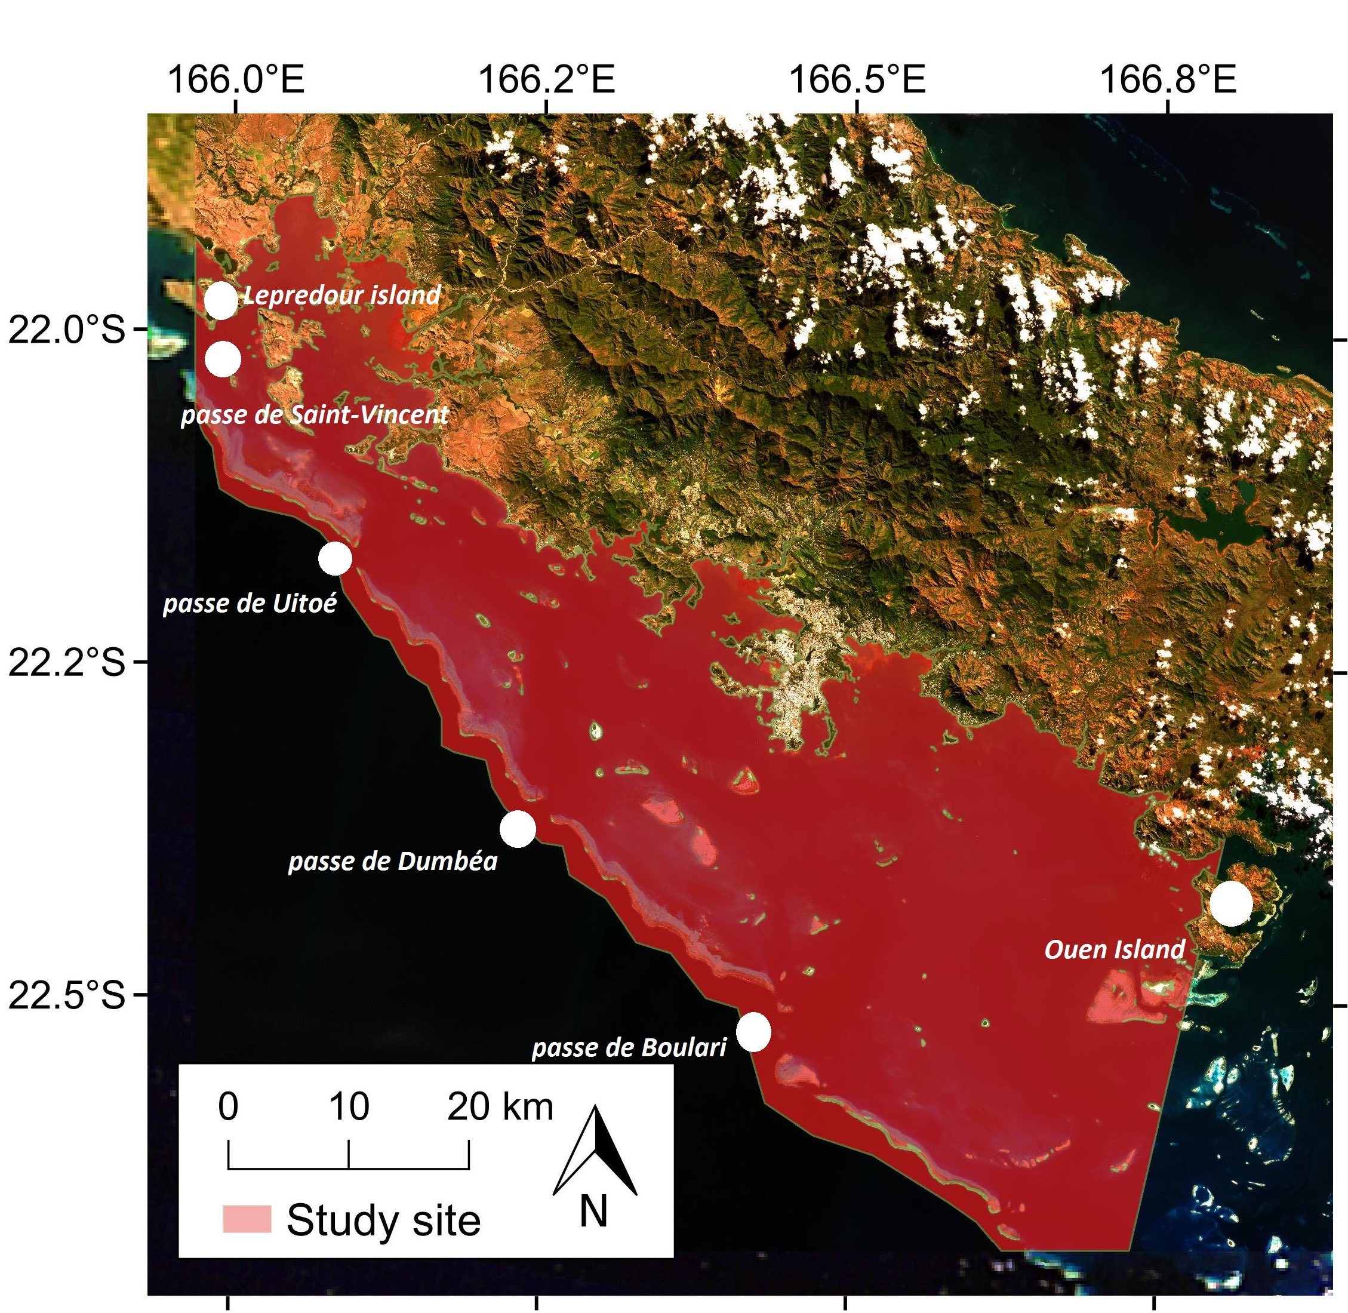
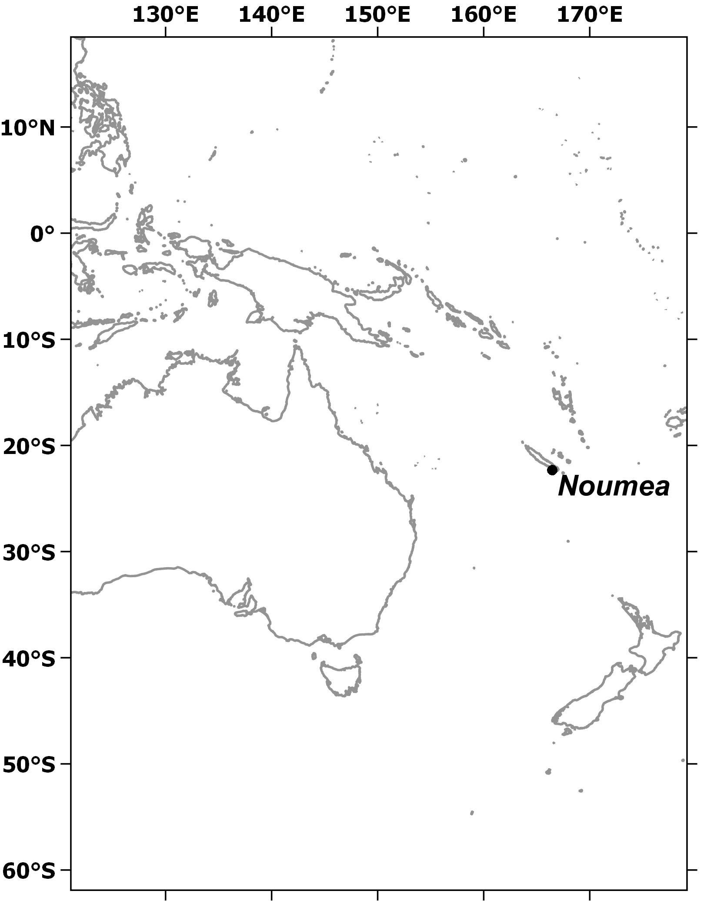
Study site: South part of the new caledonian lagoon
An extent of about 2’597.1332 km²
Semi-open area with four major channels through the barrier reef
Offers a great number of in-situ measurements by echo-sounding
set around the biggest city of the island : Nouméa

Slide 7
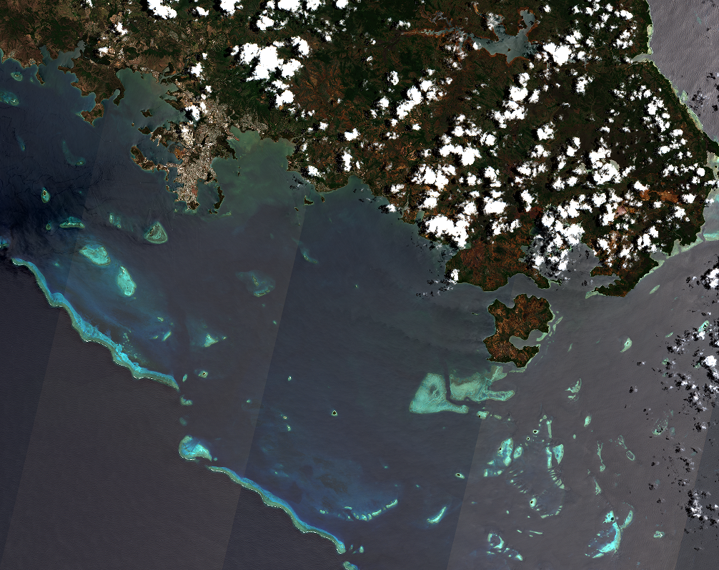
Satellite sensor and Bathymetric dataset
Satellite sensor : Sentinel-2A
Open data
Multispectral ground resolution : 10 meters
Additional blue band with shorter wavelength
Sensor composed of several detectors, set on slightly different view angles
Bathymetric dataset
Provided by the French national hydrographic service, SHOM,
Represents 18’556’254 measurements
Measured by by echo-sounder with an accuracy of +-2% of depth
Only the measurements up to 30 meters are kept
Adjusted depth following the tide
Notes:
Opend data-> allows to repeat the procedure freely
10 meters : respond to the need of numerical model
Additionnal blue bands -> higher penetration ability

Slide 8
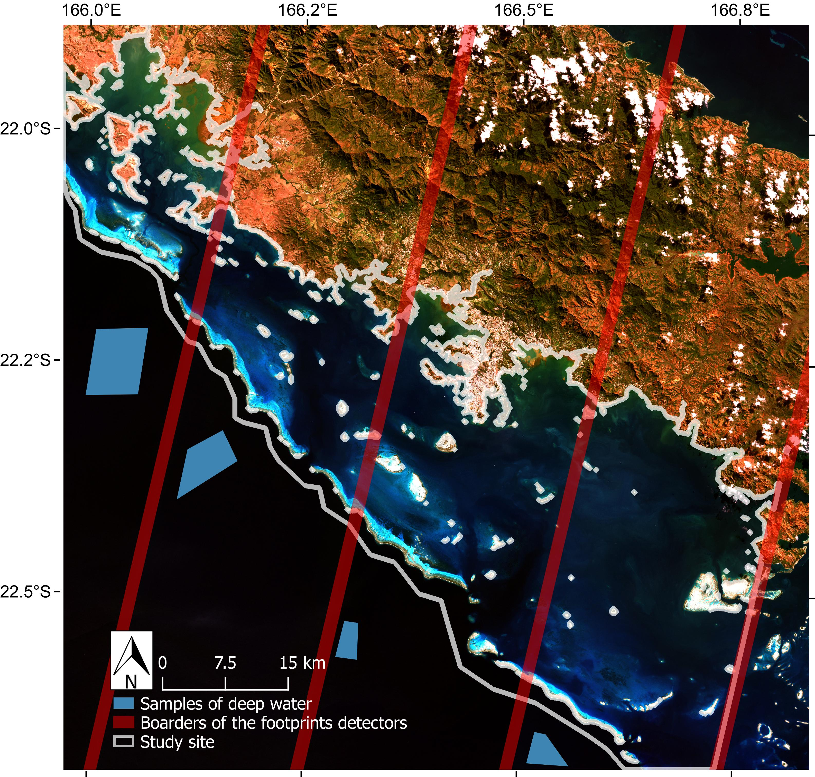
Satellite sensor and Bathymetric dataset
Satellite sensor : Sentinel-2A
Open data
Multispectral ground resolution : 10 meters
Additional blue band with shorter wavelength
Sensor composed of several detectors, set on slightly different view angles
Bathymetric dataset
Provided by the French national hydrographic service, SHOM,
Represents 18’556’254 measurements
Measured by by echo-sounder with an accuracy of +-2% of depth
Only the measurements up to 30 meters are kept
Notes:
Opend data-> allows to repeat the procedure freely
10 meters : respond to the need of numerical model
Additionnal blue bands -> higher penetration ability

Slide 9
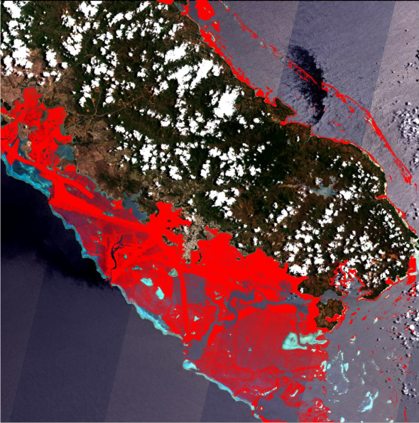
Satellite sensor and Bathymetric dataset
Satellite sensor : Sentinel-2A
Open data
Multispectral ground resolution : 10 meters
Additional blue band with shorter wavelength
Sensor composed of several detectors, set on slightly different view angles
Bathymetric dataset
Provided by the French national hydrographic service, SHOM,
Represents 18’556’254 measurements
Measured by by echo-sounder with an accuracy of +-2% of depth
Only the measurements up to 30 meters are kept
Notes:
Opend data-> allows to repeat the procedure freely
10 meters : respond to the need of numerical model
Additionnal blue bands -> higher penetration ability

Slide 10
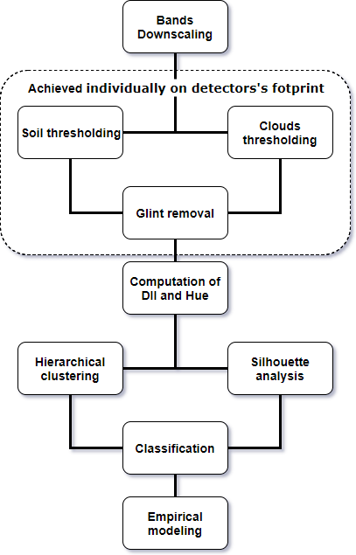
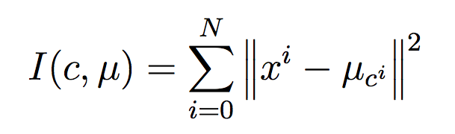
Method and results : Workflow
Downscaling of 4 bands up to 10m
Image Pre-processing :
Thresholding : empirically defined
Glint Removal
Computation of DII and Hue as descriptors
Definition of the number of clusters :
Analysis relying on Ward’s method for Hierarchical clustering
Analysis relying on Silhouette index
Bottom type and water classification by K-means :
Aims at minimizing within-clusters inertia :
Empirical models calibration
Notes:
Here is a descrioption of the workflow of the motho
First of all, 4 bands set at a lower ground resolution have to be downscal
Then image is pre-processed individually on each detector footprint. Soil and Clouds are thresholded taking advantage of spectral signatur of nat surfaces.
Glint is removed with a methodo described later
Descriptor uncorrelated from deph have to be computed and suitable number of cluster have to be chosen for the classification
After the classification, depth models are calibrated for each classes.

Slide 11
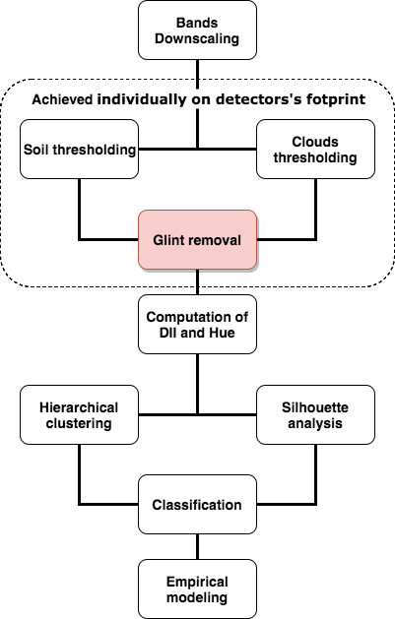
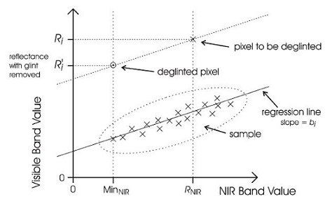
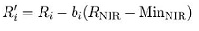
Method and results : Image pre-processing
Achieved on individually on detectors’ footprint
Sun Glint Removal :
methods of Hedley et al., 2004
Notes:
The second preprocessing is the Glint R. Very import steps as it is aims at removing the visible disparities between the detectors footprints
The method proprosed by hedley in 2004 is used.
It consist in extracting a sample of area showing an evident range of glint and homogeneous underwater brightness such as above deep water. From this sample we are using the NIR band which has almost no penetration ability in water so no volume scattering. And we are establishing a relation between the glint of each pixel and the variation of the NIR infrared band.
It is why we are extracting it above deep area.
From this sample we are using the near infrared band. Indeed it has a realy low penetration ability in water so its variation is directly linked to the glint. A relation is then established bet nir and band to correct. The value of the pixel that we want to correct is simply reduced by the product of the the regression slope and the difference between its NIR value and the observed minimum NIR value in the sample.

Slide 12
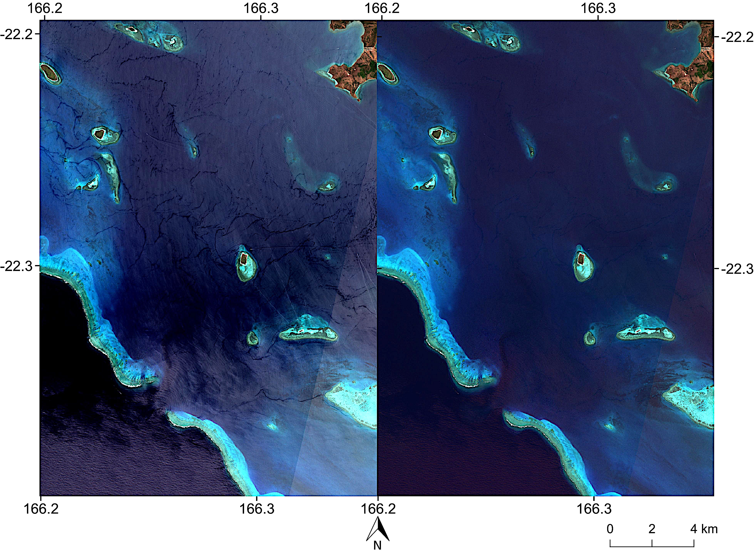
Method and results : Image pre-processing
Initial Image
Corrected Image

Slide 13
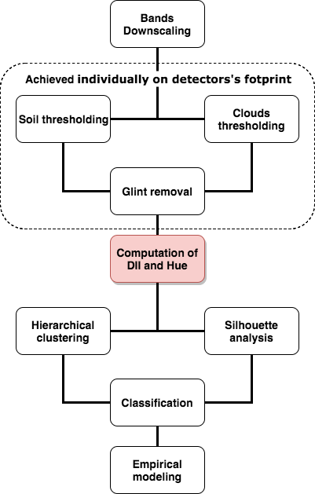
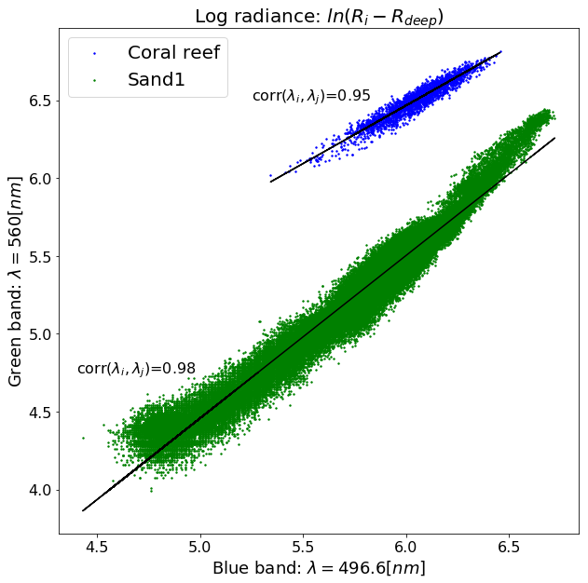
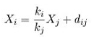
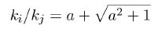
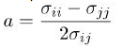
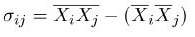
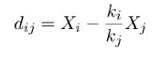
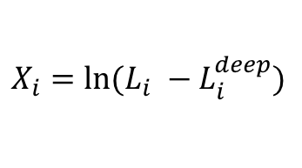
Method and results : Computation of the descriptors
Depth Invariant Index
$$X_{i}=ln⁡(L_{i} −L_{i}^{deep})$$
Hue from HSV transformation
HSV space is commonly used for aerial image classification
We made the assumption the Hue is less dependent on radiation attenuation than Red, Green, Blue, Value or Saturation
Notes:
It consist in extracting a sample of area with homogeneous bottom type. By the comparison of the logarithm signal of two different band, we observe that every pixel are set on linear trends with similar slope, dependent on the water optical properties, and different shift dependent on bottom reflectance. This shift is then representing the depth invariant Index of the pixel.
The second type of descriptor is DII. It is based on the comparision of log radiance of two band.
The log radiance are substracted from volume scattering.
In homogeneous water optical properties it is possible to observe a specific setting of the pixel along lines representing bottom reflectance.
Which has the same oriantation whose slope depend on water opti properties.
Method consist in extracting a sample of the image with homogenous bottom in order to find this slope. It is acting as a rotation in the space form by the log radiance of the two bands. Once the slope is defined

Slide 14
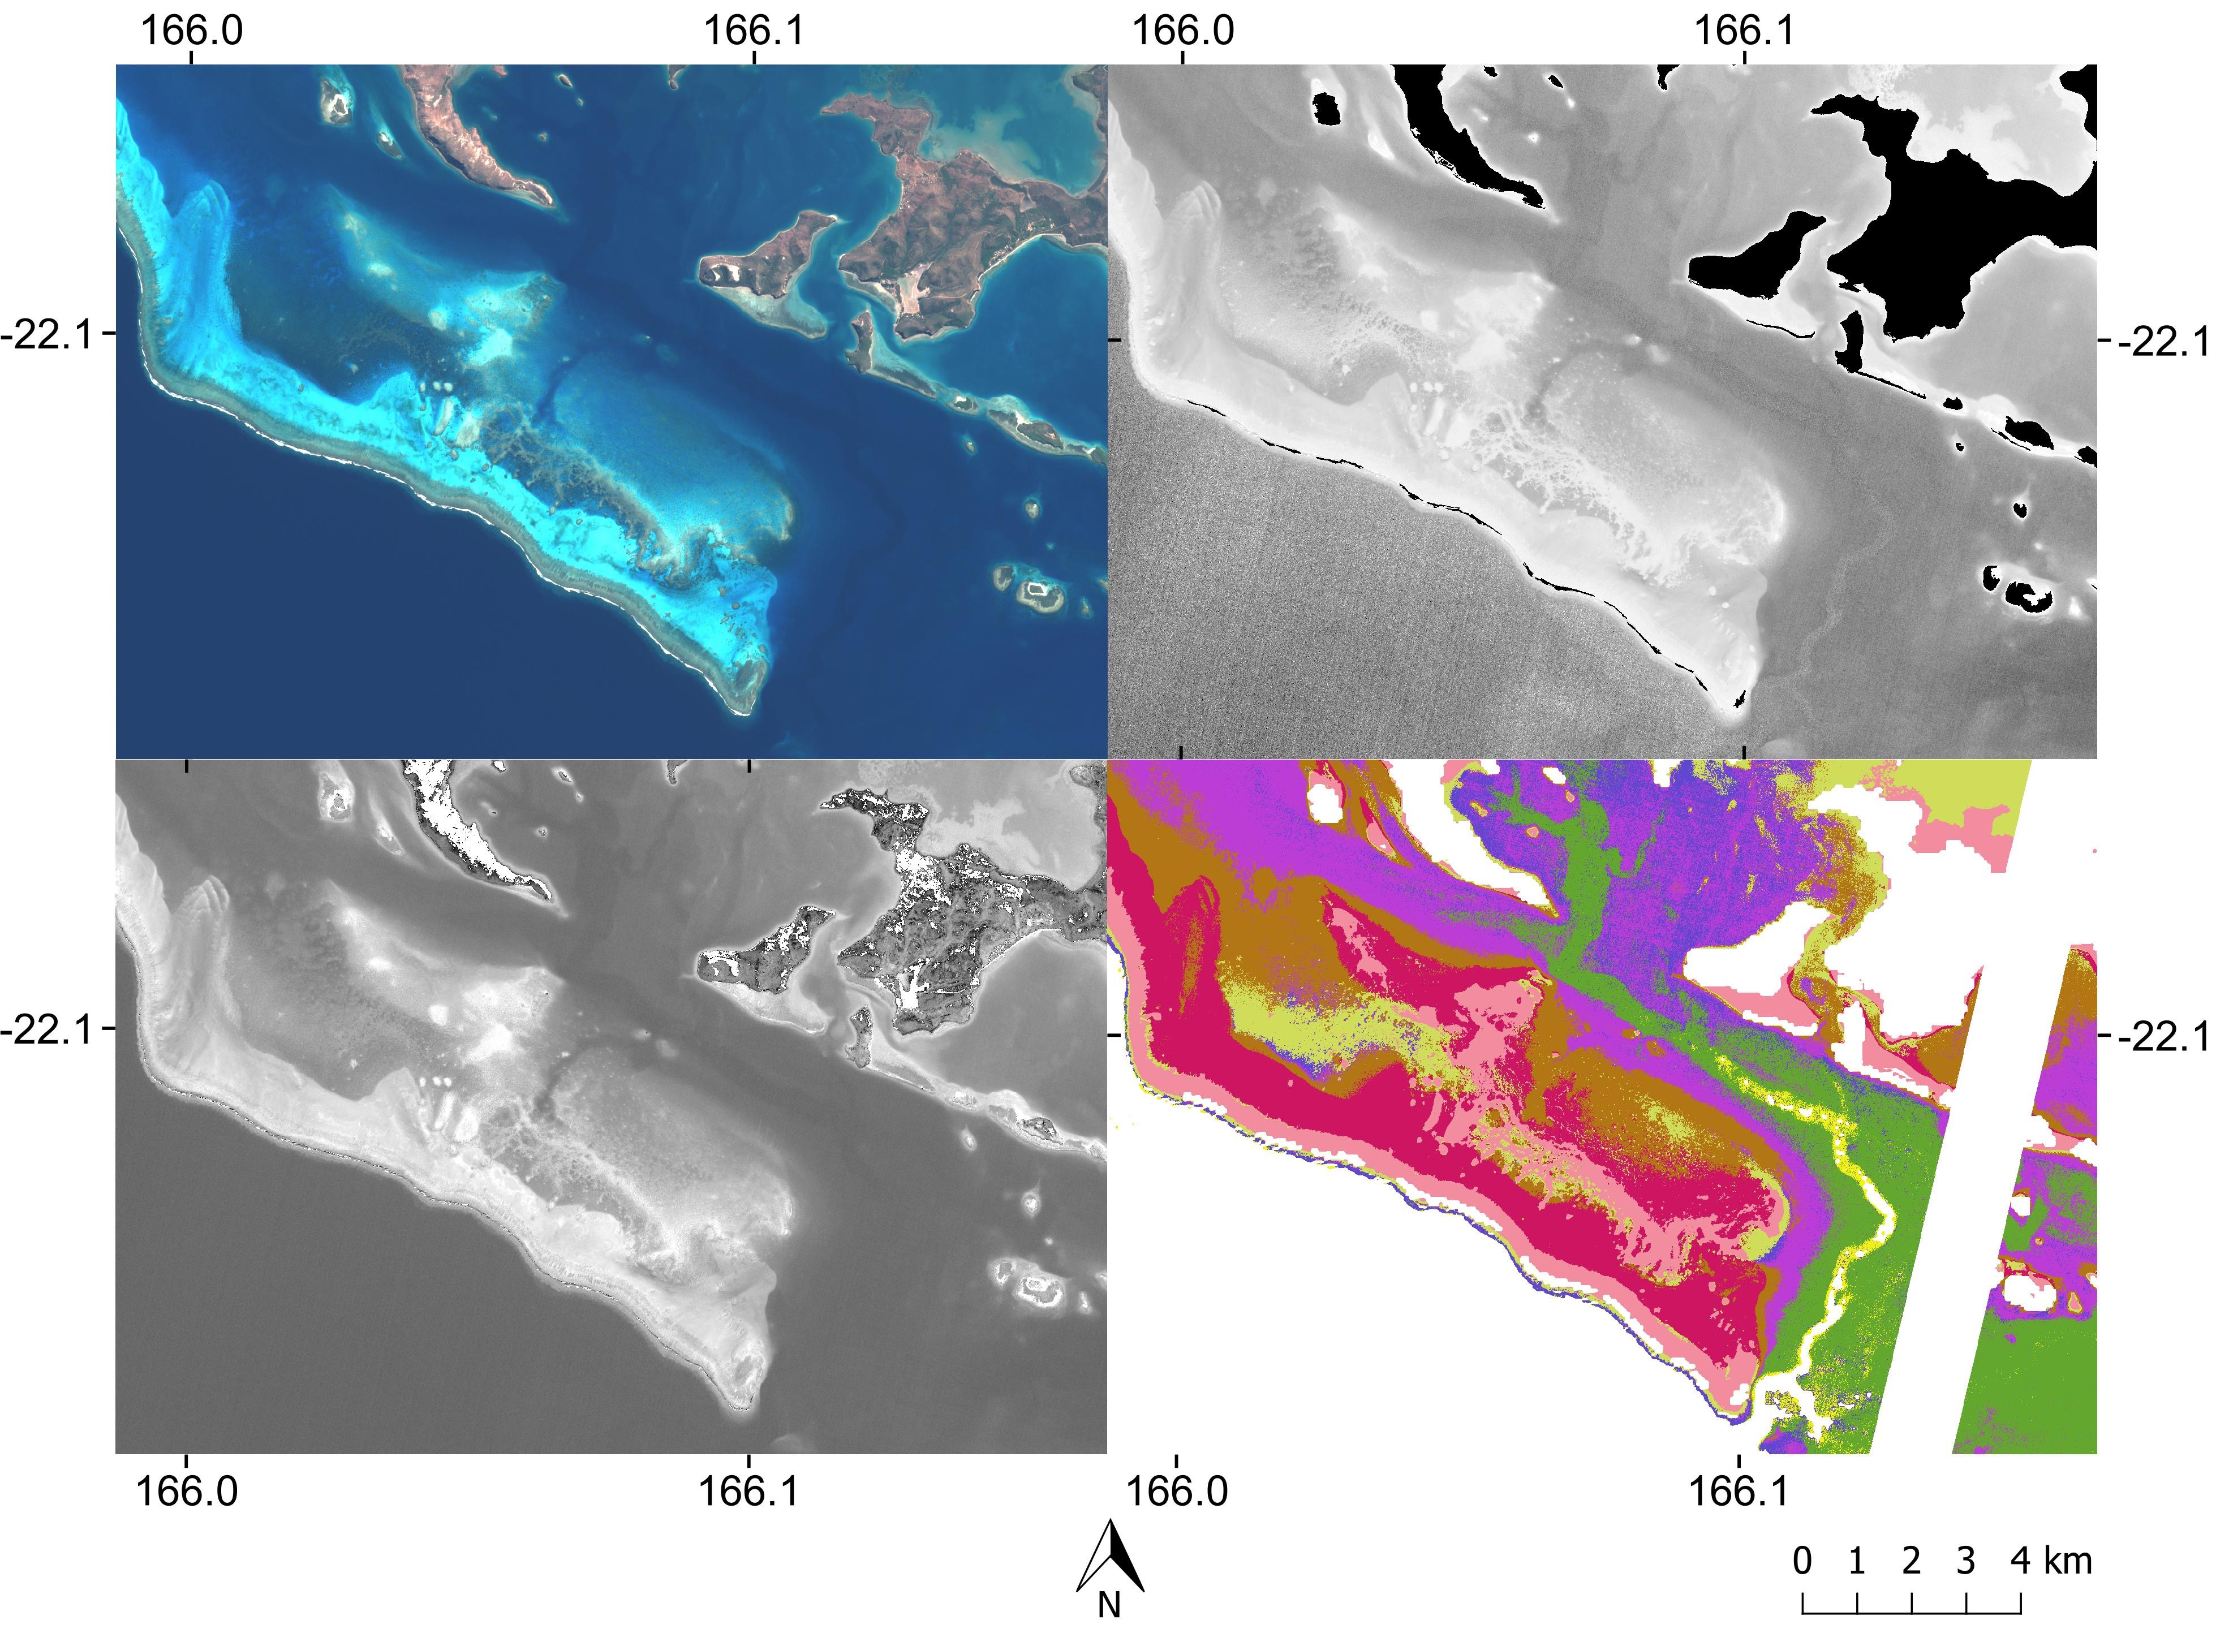
Method and results : Computation of the descriptors
Color image
DII from Green and Blue
Hue
Classification

Slide 15
Method and results : Computation of the descriptors
Color image
DII from Green and Blue
Hue
Classification

Slide 16
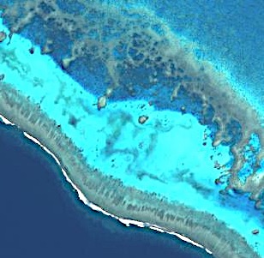
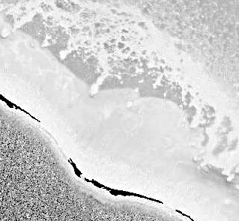
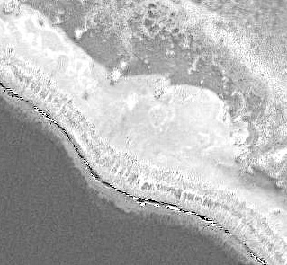
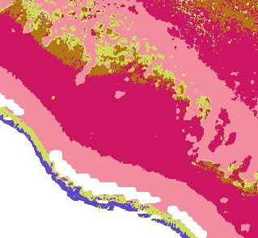
Method and results : Computation of the descriptors
Color image
DII from Green and Blue
Hue
Classification

Slide 17
Method and results : Computation of the descriptors
Color image
DII from Green and Blue
Hue
Classification
Patterns known as “blue holes” described by canyons on the back of the reefs

Slide 18
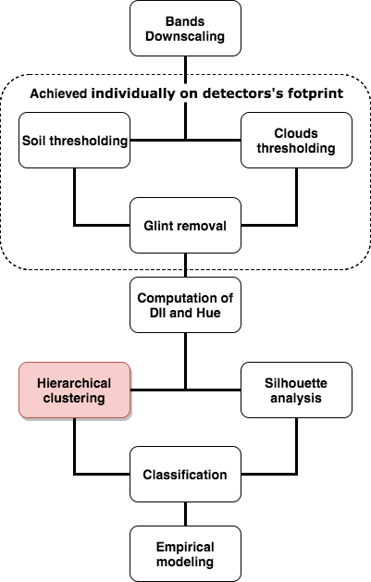
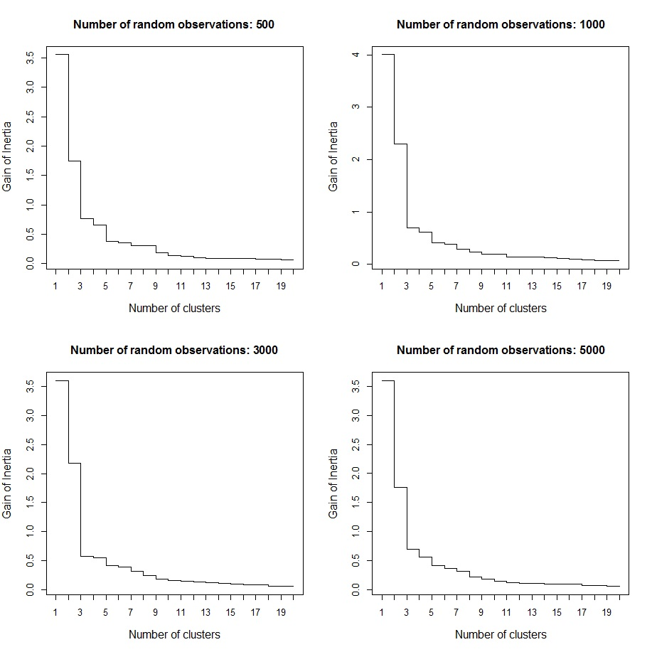
Method and results : The number of clusters
Without-cluster Inertia Loss

Slide 19
Method and results : The number of clusters
Without-cluster Inertia Loss

Slide 20
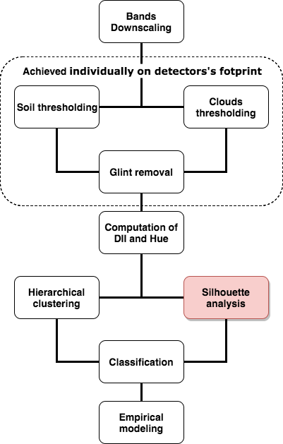
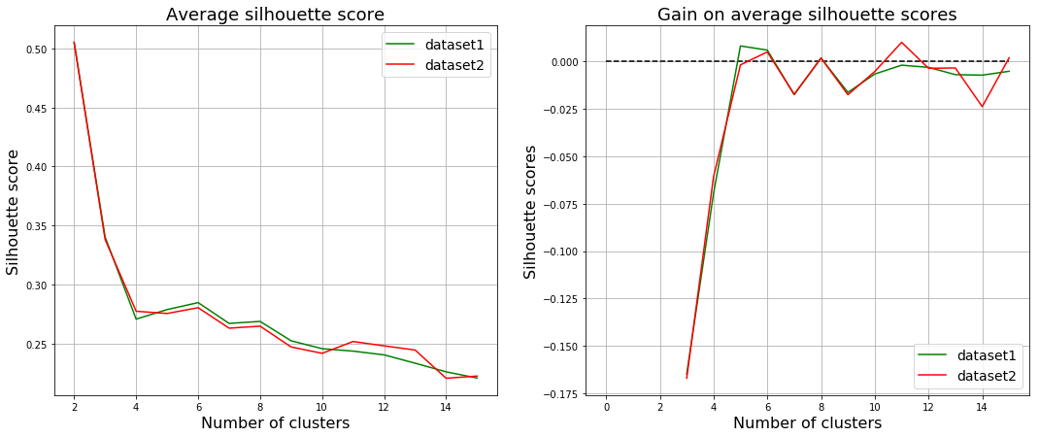
Method and results : The number of clusters
Average Silhouette score

Slide 21
Method and results : The number of clusters
Average Silhouette score

Slide 22
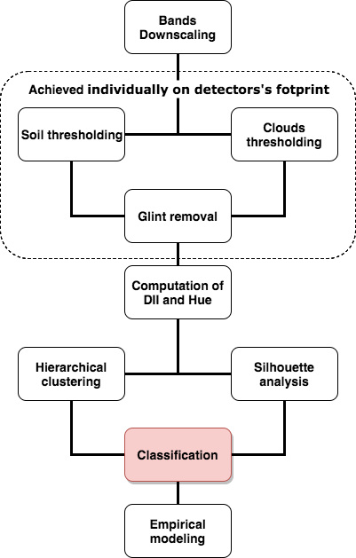
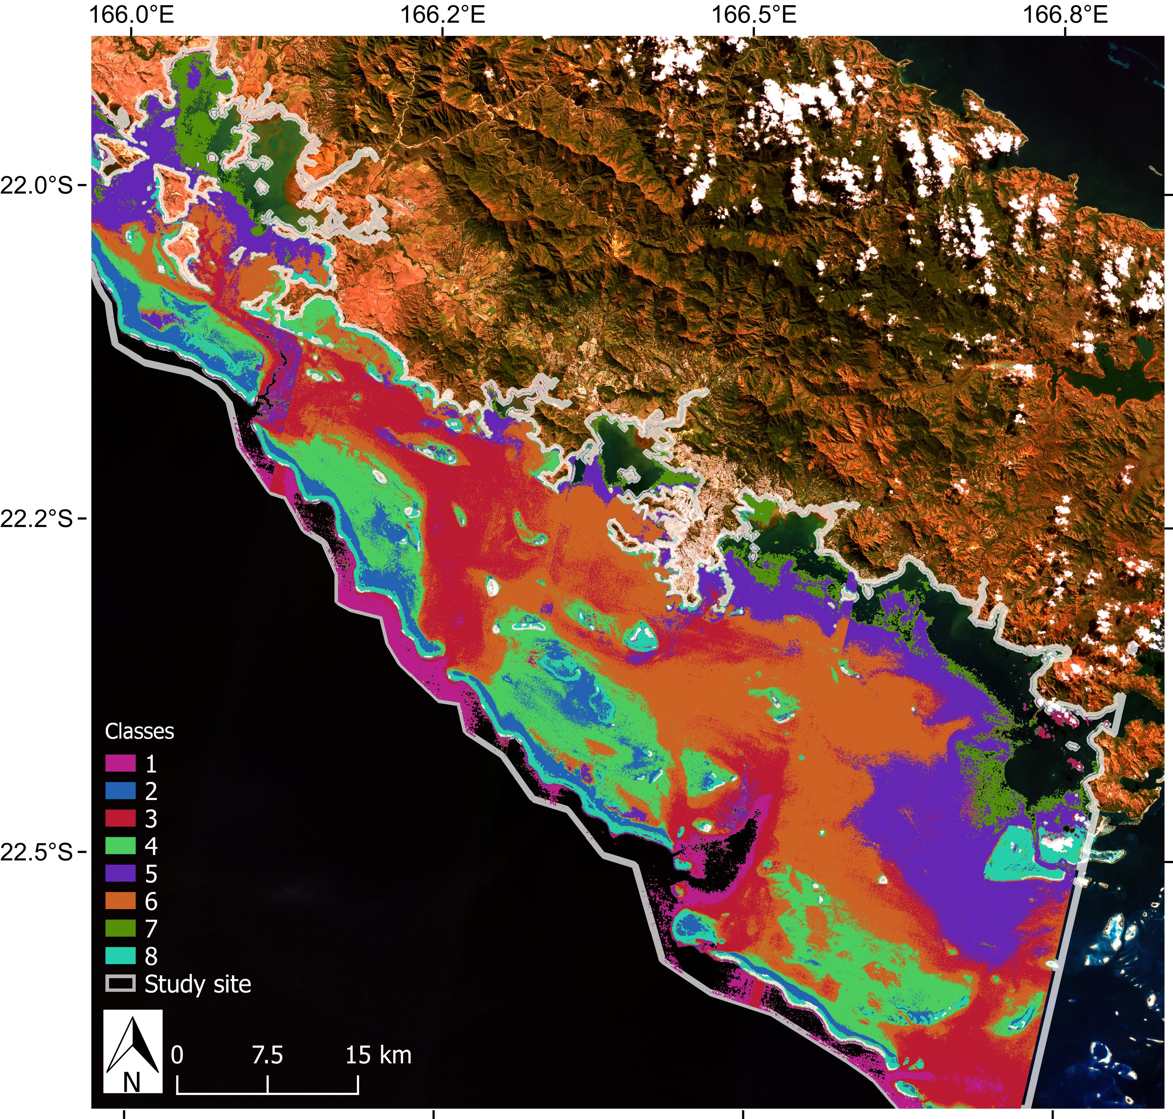
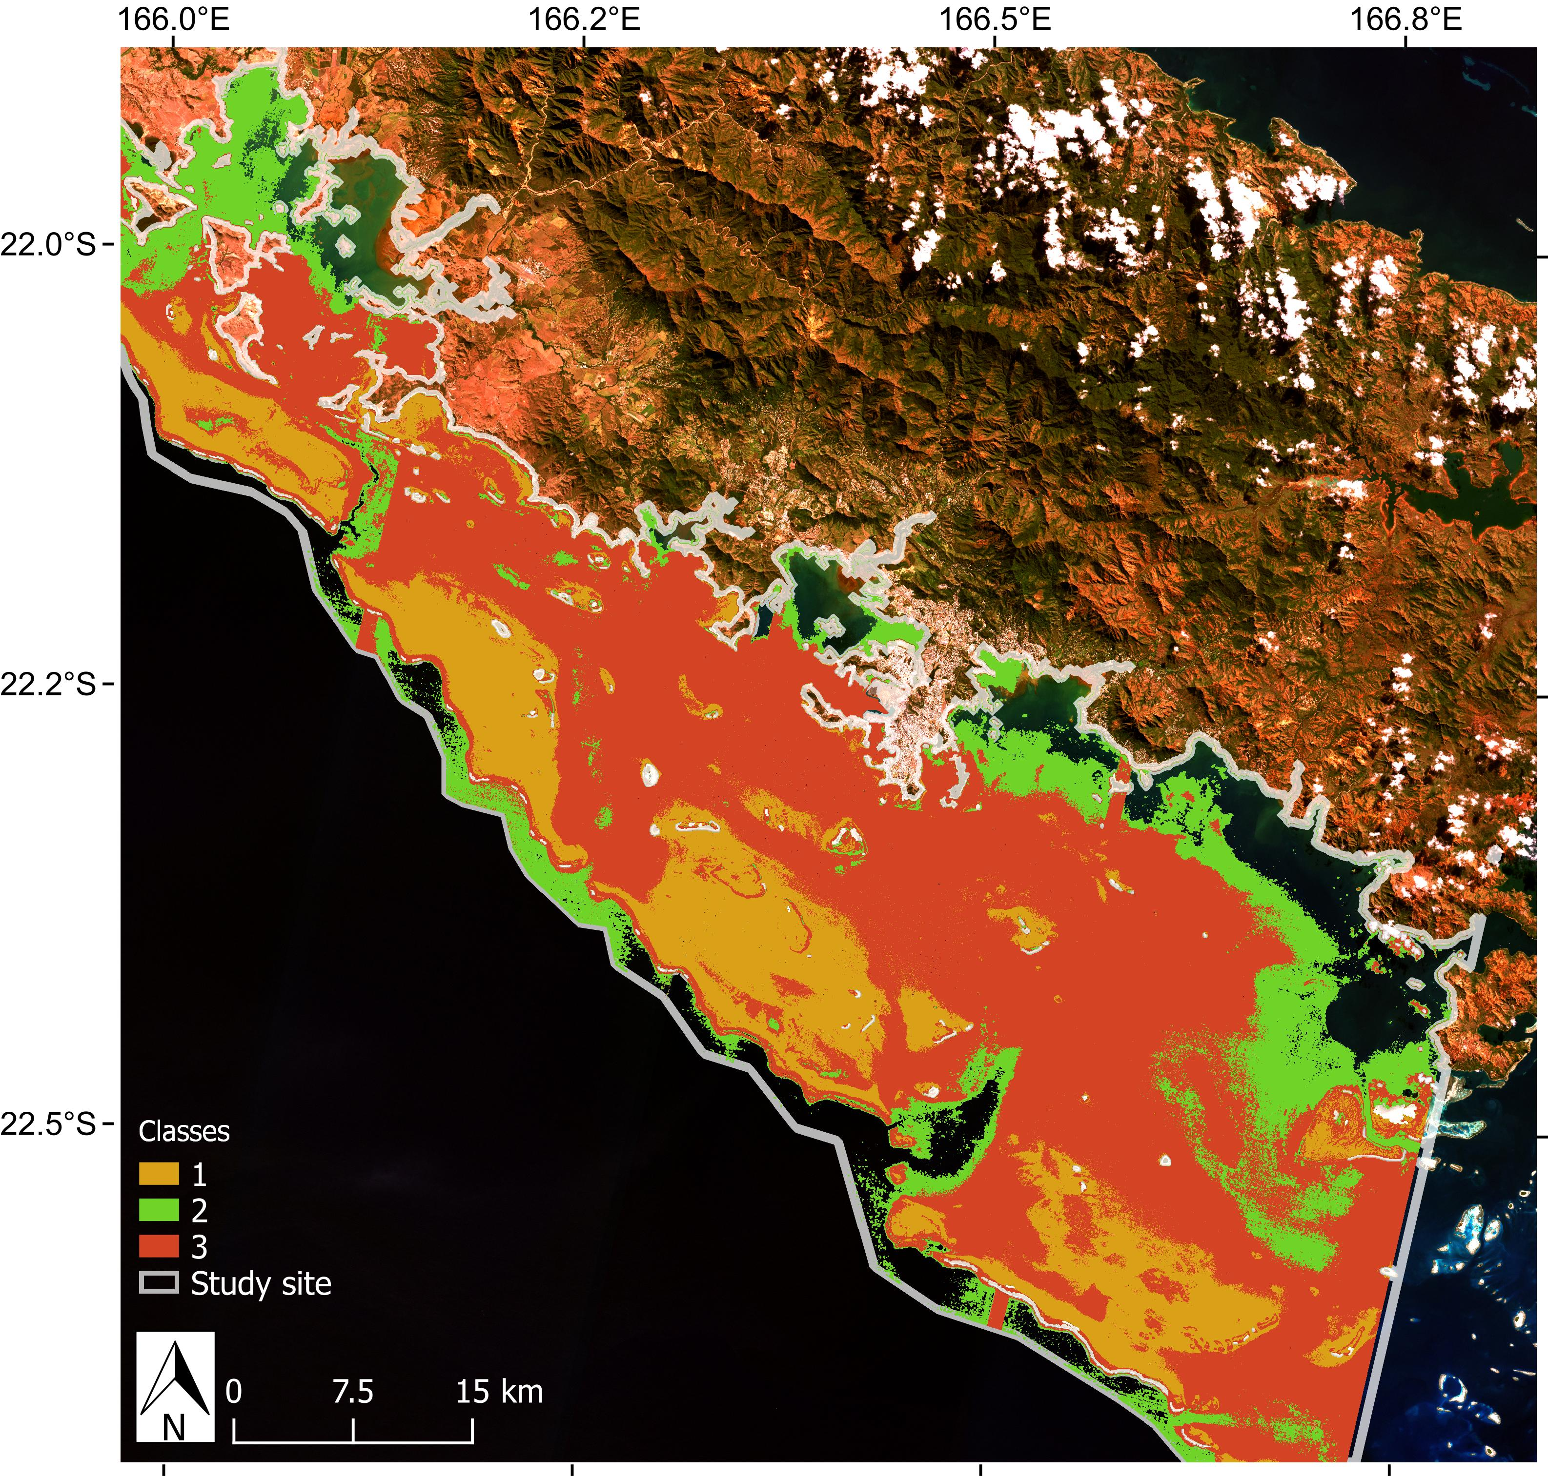
Method and results : K-means classification

Slide 23
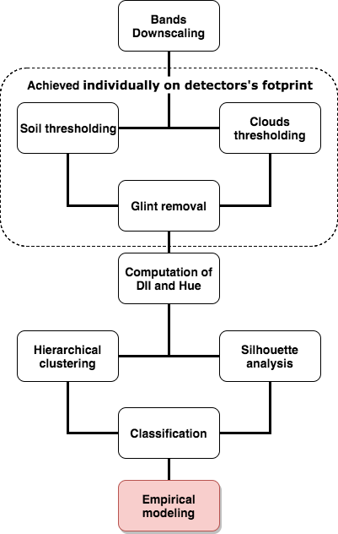
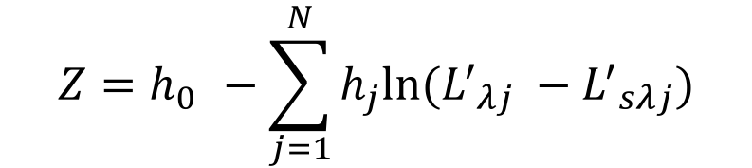
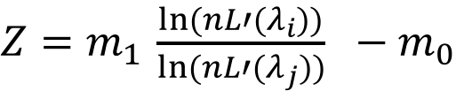
Method and results : Empirical modeling
Assumes constant water optical properties
Lyzenga
Proposes to educe errors driven by variation of bottom reflectance with a linear combination of bands
relies on the subtraction of the average deep water signal in order to get rid of the volume scattering.
Litterature :
In practice, stability and range of depth of the results is still influenced by variations of environmental parameters.
Stumpf
Relies on the wavelength dependency of the attenuation processes which assumes that ratios of signals undergo stronger variation with depth than with bottom reflectance variation
Litterature :
Should have stabler results with different bottom reflectance
Induces additional noises leading to the need a higher ground resolution
$$Z=h_{0 }−\sum_{j=1}^{N}{h_{j}ln⁡({L^{′}}_{λj} −{L^{′}}_{sλj})}$$
$Z=m_{1 }\frac{ln⁡(nL′(λ_{i}))}{ln⁡(nL′(λ_{j}))}$ $− m_{0}$

Slide 24
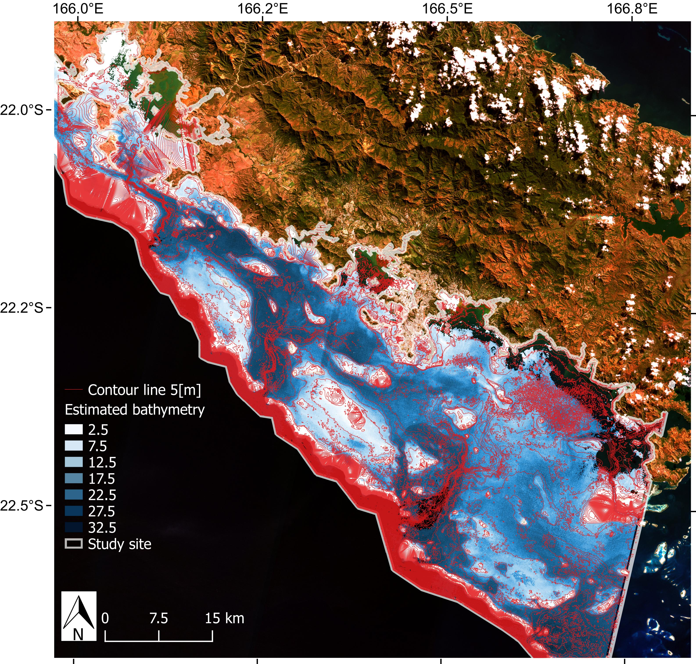
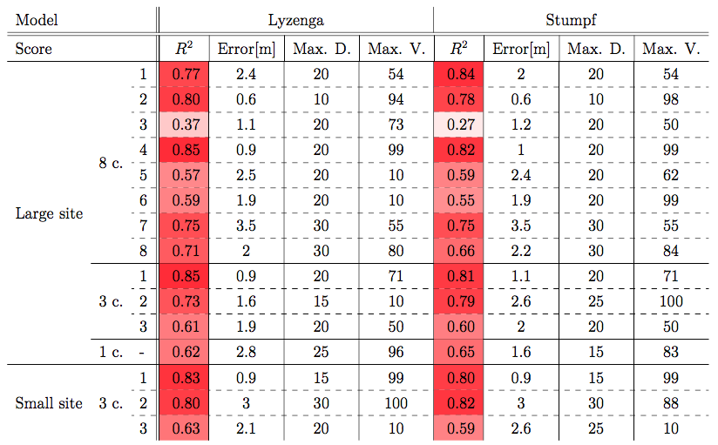
Method and results : Empirical models calibration

Slide 25
Method and results : Empirical models calibration
Lyzenga: 3 classes

Slide 26
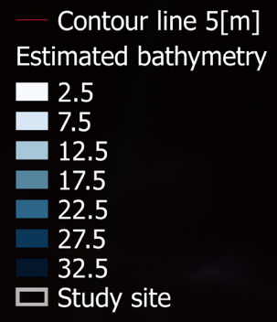
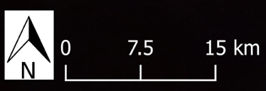
Method and results : Empirical models calibration
Lyzenga: 3 classes

Slide 27
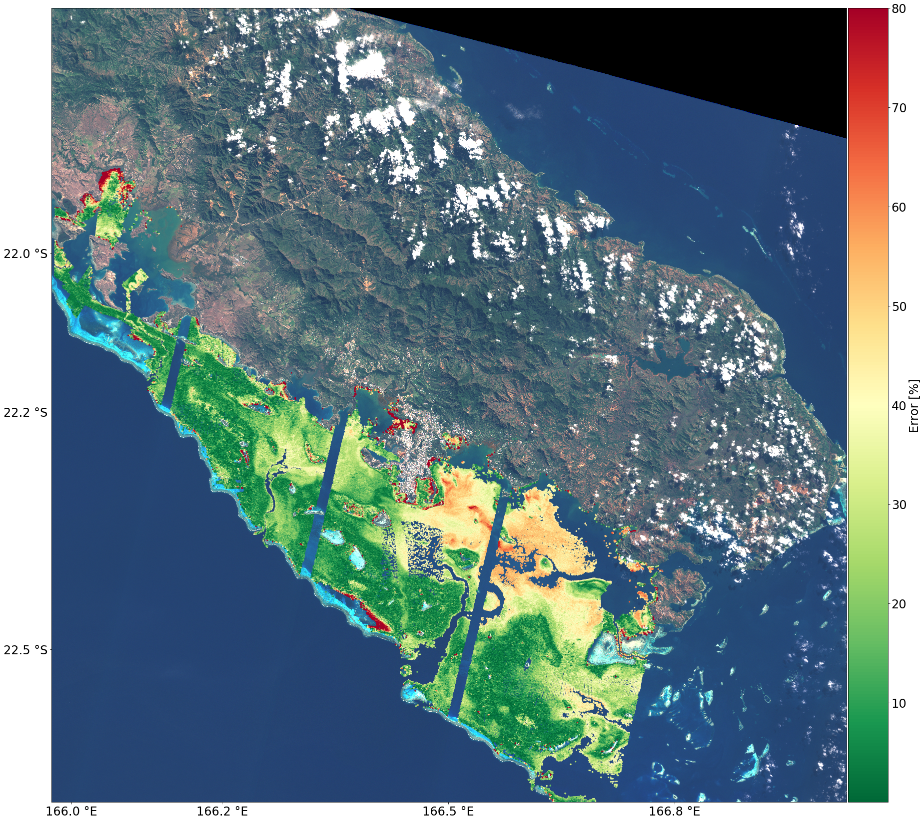
Method and results : Empirical models calibration
Lyzenga: 3 classes
Notes:
Lyzenga 3

Slide 28
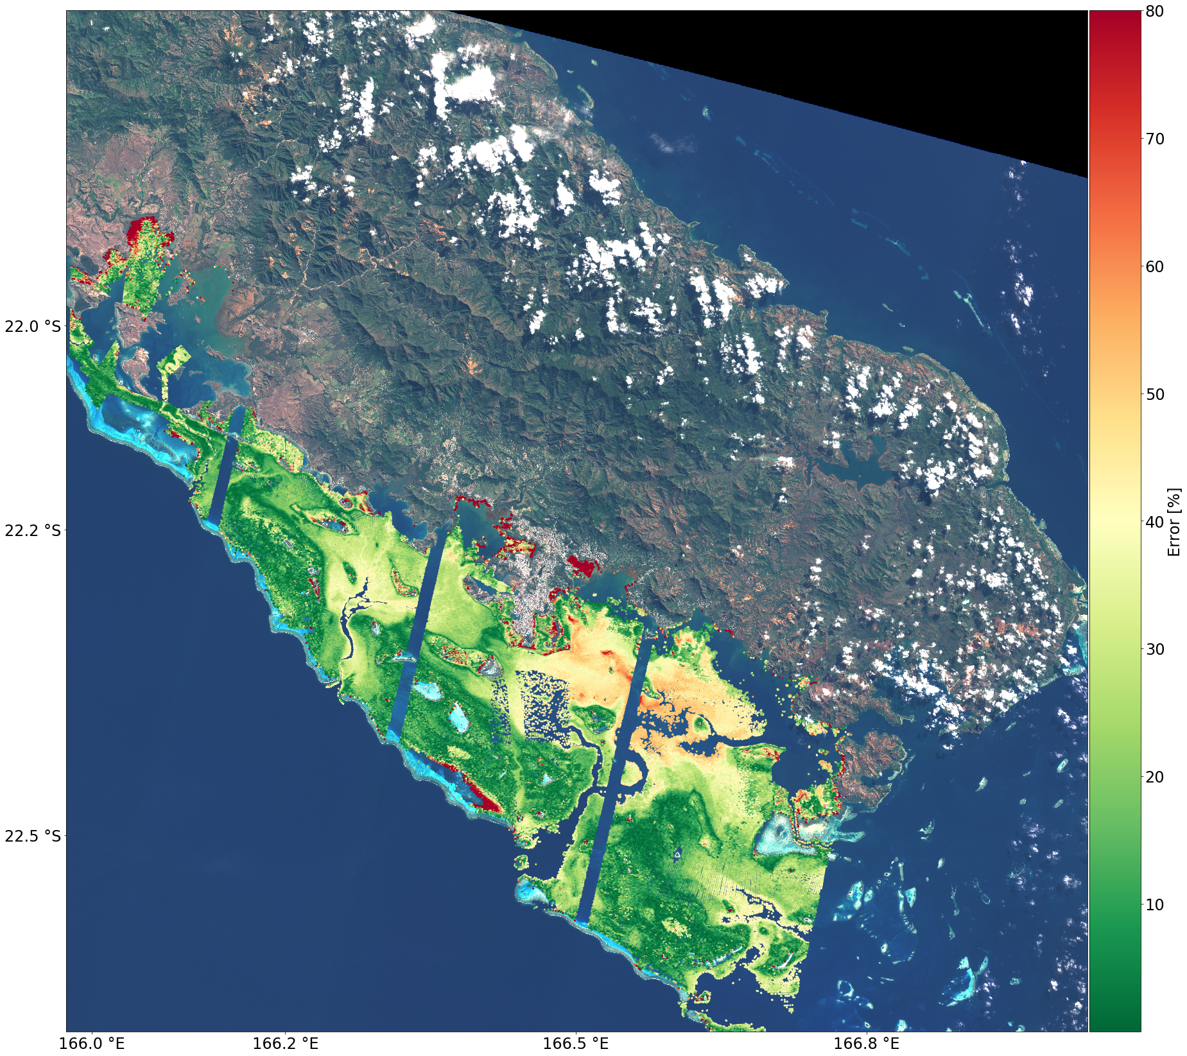
Method and results : Empirical models calibration
Stumpf: 8 classes
Notes:
Stumpf 8

Slide 29
Method and results : Empirical models calibration

Slide 30
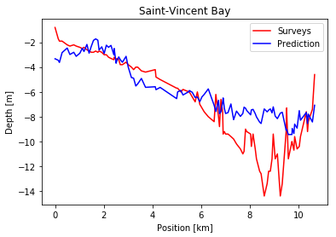
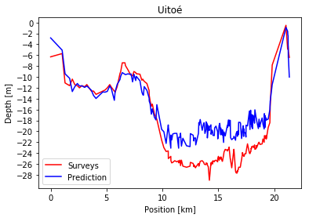
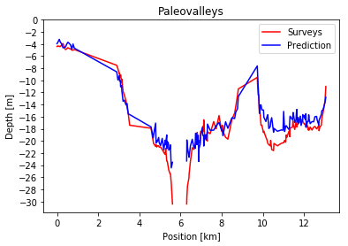
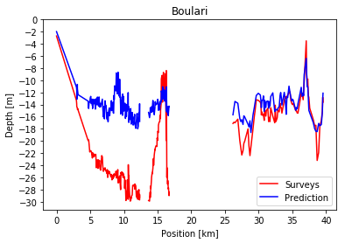
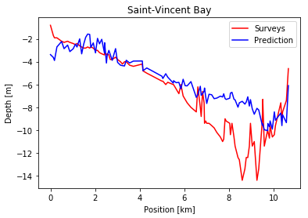
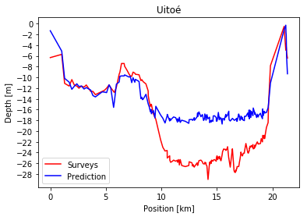
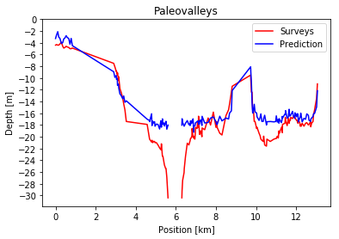

Method and results : Empirical models
Lyzenga: 3 classes
Stumpf: 8 classes
Notes:
Different range of depth prediction. In bays it tend to be limited to 10 meters
In uitoé Stumpf seems sligltly more limited

Slide 31

Discussion
Spatial correlation of the errors :areas close to the coasts
A low level clustering, allows an improvement of the precision’s performance

Slide 32

Discussion
Spatial correlation of the errors :areas close to the coasts
A low level clustering, allows an improvement of the precision’s performance
With a pre-processing achieved individually on detectors’ footpring, nothing seems to prevent the application of the empirical methods on a extended area.

Slide 33

Discussion
Spatial correlation of the errors :areas close to the coasts
A low level clustering, allows an improvement of the precision’s performance
With a pre-processing achieved individually on detectors’ footpring, nothing seems to prevent the application of the empirical methods on a extended area.
Lyzenga’s model can be evaluated as slightly better, regarding the precision of the overall models.
Lyzenga has higher precision 9/15 times

Slide 34
Conclusion
Achieved work
Sentinel-2 demonstrated its ability to produce SDB
An approach based on classification as initial has been tested
Possibility to produce large scale results is shown
Strong spatial correlation of the errors estimate, specifically close to the coast
Future work
The insertion of negative log areas in the classification results and their prediction using Stumpf model
Realization of in-situ measurments of bottom type in order to create DII
The merging of Lyzenga’s and Stumpf’s descriptiors using penalization parameter
The outliers removal before classification

Slide 35
Conclusion
Thank you for your attention
This work has been achieved with the collaboration of :
IFERMER - LEAND NC, EPFL, SHOM

Slide 36

Image pre-processing
Sun Glint Removal :
methods of Hedley et al., 2004
Achieved on individually on detectors’ footpring
Soil and Clouds thresholding
Threshold chosen by quantile computation following
estimation of the ratio of water surface
Notes:
The second preprocessing is the Glint R. Very import steps as it is aims at removing the visible disparities between the detectors footprints
The method proprosed by hedley in 2004 is used.
It consist in extracting a sample of area showing an evident range of variation of glint but with homogeneous underwater brightness.
It is why we are extracting it above deep area.
From this sample we are using the near infrared band. Indeed it has a realy low penetration ability in water so its variation is directly linked to the glint. A relation is then established bet nir and band to correct. The value of the pixel that we want to correct is simply reduced by the product of the the regression slope and the difference between its NIR value and the observed minimum NIR value in the sample.

Slide 37

Bottom type and water classification (1)
K-means classifier
Aims at minimizing within-clusters inertia :
Initialize K cluster centroids $µ_{1, }µ_{2,}$…, $µ_{k,}∈ R^{d}$
Iterate until convergence:
Every observation is assigned to the closest cluster: $c_{i}:= argmin ∥x_{i} − μ_{k}∥2$
Update the clusters’ centroid position : $μ_{k}≔\frac{\sum_{i=0}^{N}{\left\langle c_{i==k}\right\rangle x_{i}}}{\sum_{i=0}^{N}{\left\langle c_{i==k}\right\rangle }}$
Requires to define the number of clusters
Every descriptors are standardized previously standardized
Notes:
Commonly used in image classification

Slide 38


The number of clusters
Agglomerative hierarchical clustering
Start with each observation as a cluster
Until only one cluster remains:
Find the closest pair of clusters.
Merge them.
Ward’s method:
Define a measure of distance between clusters
aims at minimizing the within-clusters inertia
Allows to observe the change in Inertia
Silhouette index
Define a measure of how well an observation fit in a cluster

Slide 39

Bottom type and water classification (2)
Hue from HSV transformation
HSV space is commonly used for aerial image classification
HSV transformation from a usual Red, Green, Blue space
to a space formed by three other values:
The Hue, the value, the saturation
We made the assumption the Hue is less dependent on radiation attenuation than Red, Green, Blue, Value or Saturation
Depth Invariant Index
$$X_{i}=ln⁡(L_{i} −L_{i}^{deep})$$
Notes:
The second type of descriptor is DII. It is based on the comparision of log radiance of two band.
The log radiance are substracted from volume scattering.
In homogeneous water optical properties it is possible to observe a specific setting of the pixel along lines representing bottom reflectance.
Which has the same oriantation whose slope depend on water opti properties.
Method consist in extracting a sample of the image with homogenous bottom in order to find this slope. It is acting as a rotation in the space form by the log radiance of the two bands. Once the slope is defined

Slide 40


Physic principles in water surrounding
Radiance
recorded by the satellite sensor
corresponds to a measure of the electromagnetic radiation flux emitted or reflected by a surface
dependent on :
The area of the source,
The view and solid angles of the sensor,
The wavelength
The irradiance
Reflection
Diffuse or specular
Attenuation
Come from the Absorption and the scattering
$$L\left(h\right)=L_{G}+ L_{s} −L_{b}e_kh$$
Notes:
Rapidly I would like to describe some basic physic principle :
Radiance first a all is the recorded signal from satellite sesor. It is a measure of the electromagnetic radiation emitted or reflected by surfaces but it is not reflectance.
Reflection: I want you to know that there is two type of reflection: diffuse ref wich produce equal ref in every direction and spec ref which produce rel in a specific direction. Above water, ref is mixture of both with spectular reflection which is responsible for the glint
Attenuation in water surrounding which is composed of absorbation , a molecure processes and scattering a change in the radiation direction. Attenuation is strongly dependent on the wavelength and on the water optical properties
As a resume 3 main factors of variaiton of the recoreded signal : deepth as it make vary the amount of att along the pathway, bottom type as it as its own reflectance, and wateer optical propertie which make change the coef of attenuation.
Sensored radiance is composed of a radiance component reflected by the bottom and attenuated along the pathway but also on the volume scattering component which is radiance scattered multiple time and never reaching the botto. It is what we observed above deep water.
We can also add the glint.
2 minutes
Recorded signal by satelite is called the radiance. Not only dependent on the observed surface different, from reflectance
Reflection : is made of two different king of process.
Attenuation occuring in water surrounding produced two primary components. Absorption, molecular process energy of radiation is absorbed by the mater. Scattering which is a change in direction of radiation. It strongly dependent on the wavelength of radiation. Charactherized by a attenutation coefficient dependent on the water optical properties
Why am I telling you that : 3 main factor of variation of the recorded signal occuring in water surrounding. Bottom type _> bottom reflectance. The depth, which increase the amount of attenuation along the pathway, water compound change the water attenuation coefficient

Slide 41
Physic principles in water surrounding
Radiance
recorded by the satellite sensor
corresponds to a measure of the electromagnetic radiation flux emitted or reflected by a surface
dependent on :
The area of the source,
The view and solid angles of the sensor,
The wavelength
The irradiance
Attenuation
Come from the Absorption and the scattering
$$L\left(h\right)=L_{G}+ L_{s} −L_{b}e_kh$$
Notes:
Rapidly I would like to describe some basic physic principle :
Radiance first a all is the recorded signal from satellite sesor. It is a measure of the electromagnetic radiation emitted or reflected by surfaces but it is not reflectance.
Reflection: I want you to know that there is two type of reflection: diffuse ref wich produce equal ref in every direction and spec ref which produce rel in a specific direction. Above water, ref is mixture of both with spectular reflection which is responsible for the glint
Attenuation in water surrounding which is composed of absorbation , a molecure processes and scattering a change in the radiation direction. Attenuation is strongly dependent on the wavelength and on the water optical properties
As a resume 3 main factors of variaiton of the recoreded signal : deepth as it make vary the amount of att along the pathway, bottom type as it as its own reflectance, and wateer optical propertie which make change the coef of attenuation.
Sensored radiance is composed of a radiance component reflected by the bottom and attenuated along the pathway but also on the volume scattering component which is radiance scattered multiple time and never reaching the botto. It is what we observed above deep water.
We can also add the glint.
2 minutes
Recorded signal by satelite is called the radiance. Not only dependent on the observed surface different, from reflectance
Reflection : is made of two different king of process.
Attenuation occuring in water surrounding produced two primary components. Absorption, molecular process energy of radiation is absorbed by the mater. Scattering which is a change in direction of radiation. It strongly dependent on the wavelength of radiation. Charactherized by a attenutation coefficient dependent on the water optical properties
Why am I telling you that : 3 main factor of variation of the recorded signal occuring in water surrounding. Bottom type _> bottom reflectance. The depth, which increase the amount of attenuation along the pathway, water compound change the water attenuation coefficient

